Slide 1

Tomato Leaf Disease detection using Deep Learning
Indian Institute of Technology, Ropar
EE673: Deep Learning for Computer Vision
Mayur Pritam Das – 2023CSM1007
Praphul P. Thekkila – 2023AIM1011
SUMMER 2024

Slide 2

INTRODUCTION
Leaves can provide valuable information about the health of a plant
Important to differentiate between healthy, diseased, and stressed leaves
Detecting disease type, stage, and severity is crucial for timely remedies
Project Objective:
Develop a 2-stage deep learning pipeline
Stage 1: Classify leaves as healthy, stressed, or diseased
Stage 2: For diseased leaves, detect disease type and progression stage
Aim: Improve crop yield by enabling precise and fast remedial actions

Slide 3
LITERATURE REVIEW
Bahrami et al. (2024):
Used pre-trained models (VGG19, ResNet-101, MobileNet-v2) for classification
Comparative study on PlantVillage and CCMT datasets
Found VGG19 gave the best performance
Brucal et al. (2023):
Employed YOLOv8 model for tomato leaf disease detection
Achieved mean Average Precision (mAP) of 98.9%
Did not consider differentiating stressed and diseased leaves
Fu et al. (2023):
Proposed DCNet, a custom CNN architecture
Used dilated convolution, batch normalization, and dropout
Focused on classifying disease types, not localization

Slide 4
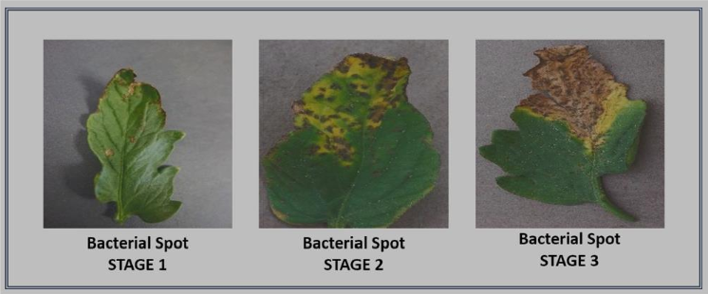
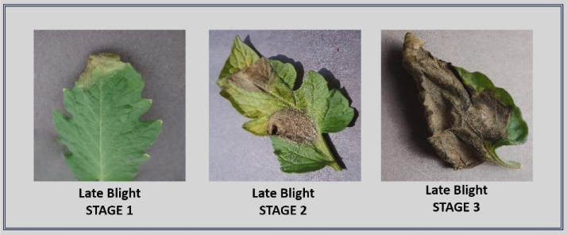
Common Diseases in Tomato Leaves
Bacterial Spot:
Caused by Xanthomonas bacteria
Dark brown/black lesions on leaves
Early Blight:
Caused by fungus Alternaria
Dark spots with concentric rings
Late Blight:
Caused by Phytophthora infestans
Green/brown patches, pale borders
Septoria Leaf Spot:
Caused by Septoria lycopersici fungus
Small brown spots with light centers

Slide 5
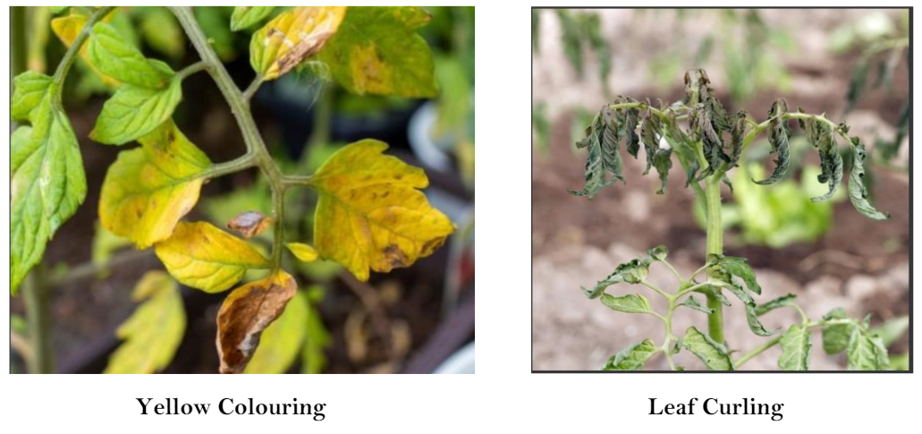
Stress in Tomato Leaves
Yellow Coloring:
Due to nitrogen deficiency
Overwatering causes nutrient deficiency
Leaf Curling:
High temperatures
Under/overwatering

Slide 6
DATASET DESCRIPTION
MSDS-Iv3 Dataset:
3 classes: Tomato_Healthy, Tomato_Stressed, Tomato_Diseased
~1000 images per class
Used for Stage 1 Classification
MSDS-Yv8 Dataset:
13 annotated classes
5 diseases, each with 3 progression stages
~100 images per class
Used for Stage 2 Object Detection

Slide 7
METHODOLOGY

Slide 8
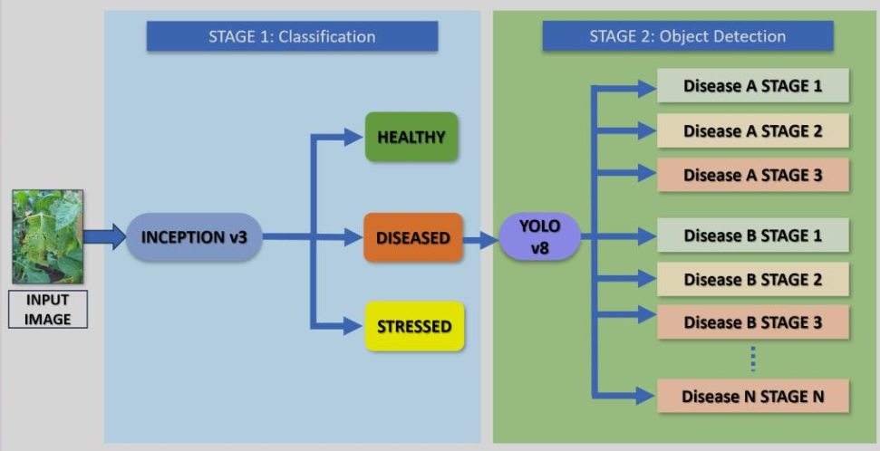
METHODOLOGY
Two-Stage Deep Learning Pipeline:

Slide 9
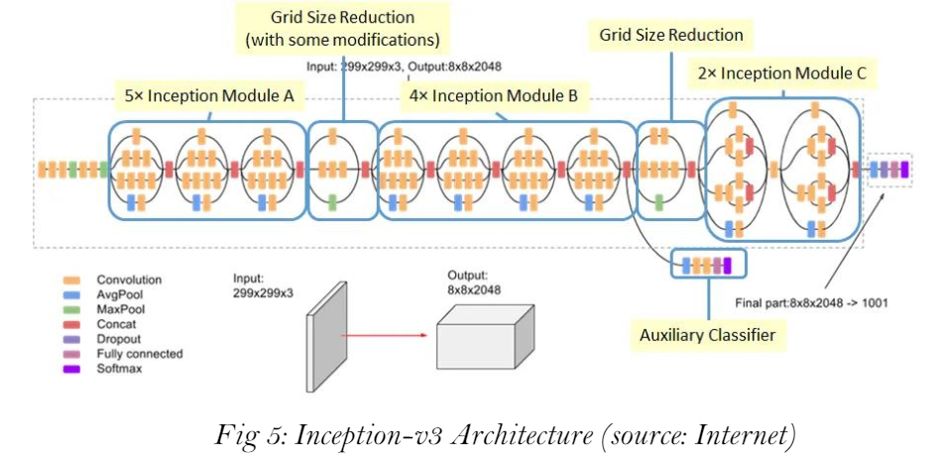
METHODOLOGY
Stage 1: Classification (Healthy, Stressed, or Diseased)
Inception v3 model with transfer learning
Trained on custom MSDS-Iv3 dataset
Removes ambiguity between stressed and diseased leaves

Slide 10
METHODOLOGY
Stage 2: Object Detection for Disease Analysis (if Stage 1 output is "Diseased")
YOLOv8 model for multi-class object detection
Trained on custom annotated MSDS-Yv8 dataset
Detects disease type and localization
Identifies disease progression stage

Slide 11
METHODOLOGY
Key Steps:
Input tomato leaf image
Stage 1: Inception v3 classification
If "Diseased", go to Stage 2
Stage 2: YOLOv8 object detection and disease analysis
Output: Disease type, localization, and progression stage

Slide 12

Web App Development
Web Application Interface:
Developed to provide an end-user solution
Backend: Flask app with deep learning pipeline
Frontend: HTML, CSS, and JavaScript
Functionalities:
User uploads a tomato leaf/plant image
Pipeline processes the image
Detects anomaly (stress or specific disease)
Displays results comprehensively
Suggests remedial actions (future work)
Data analysis for commercial purposes (future work)

Slide 13
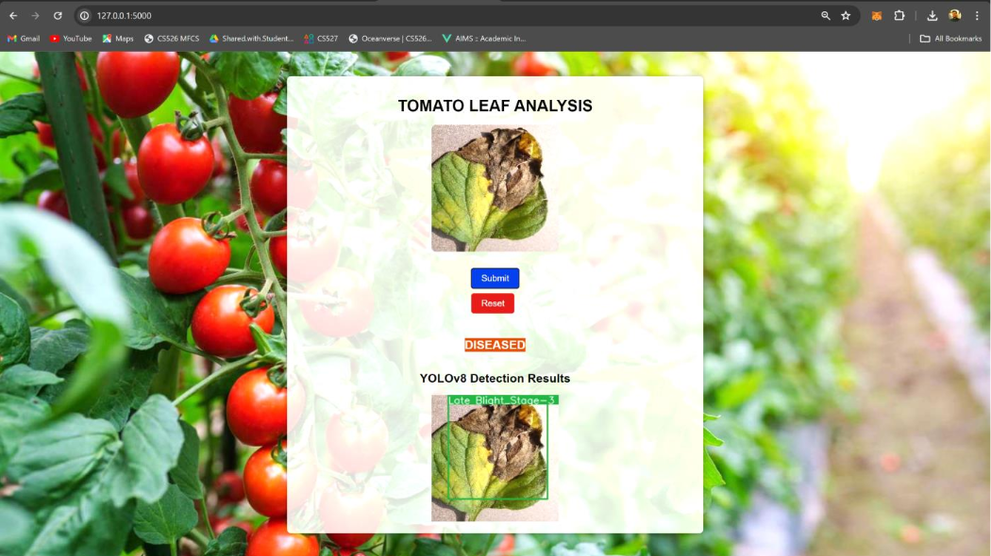
Web App Development

Slide 14
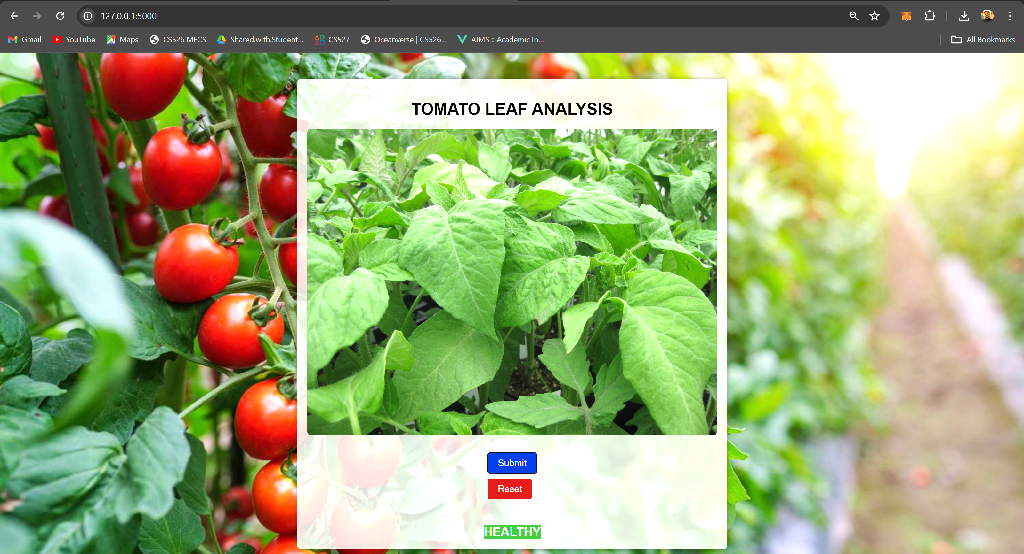
Web App Development

Slide 15
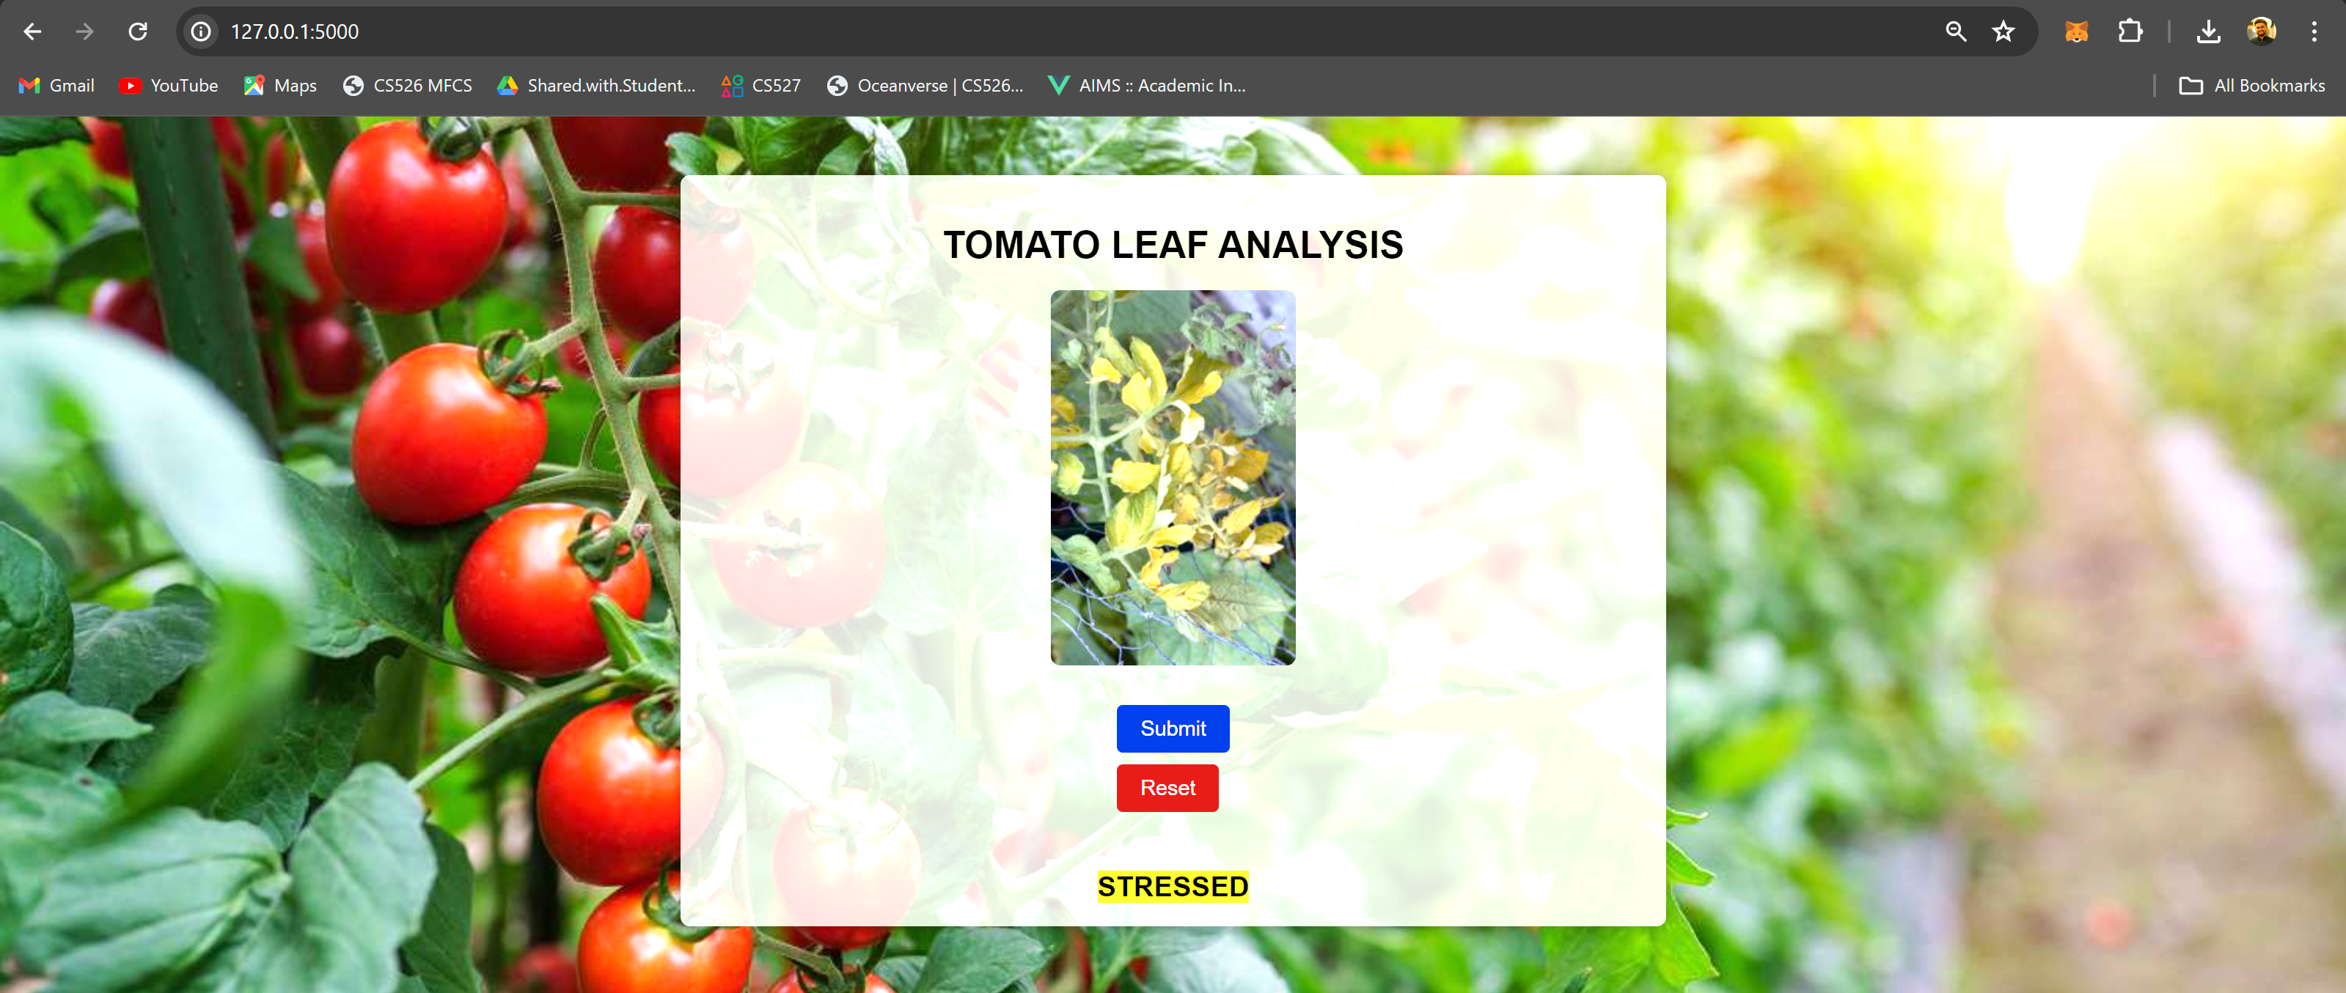
Web App Development

Slide 16
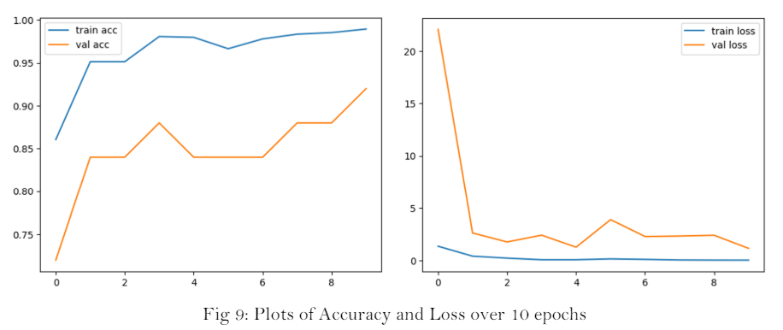
Experimentation Results
Classification with Inception v3 (MSDS-Iv3):
Accuracy: 88-92% across multiple runs

Slide 17
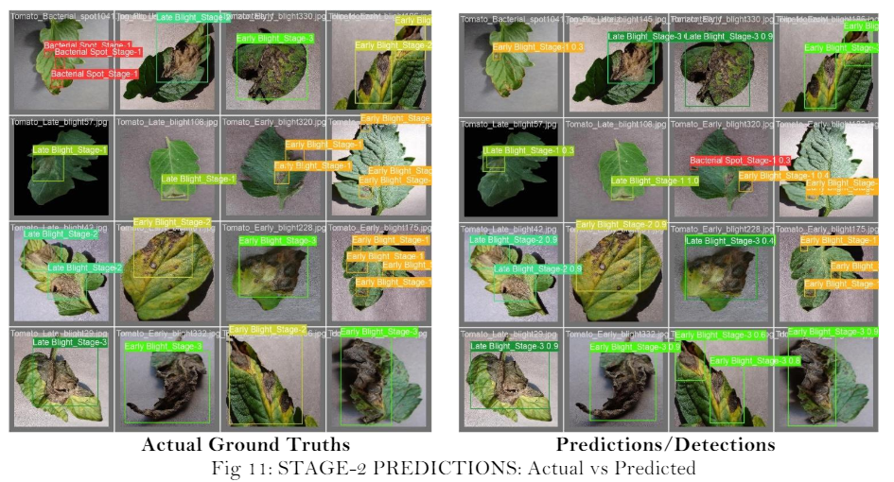
Experimentation Results
Object Detection with YOLOv8 (MSDS-Yv8):
13 classes, 5 diseases with 3 stages each

Slide 18
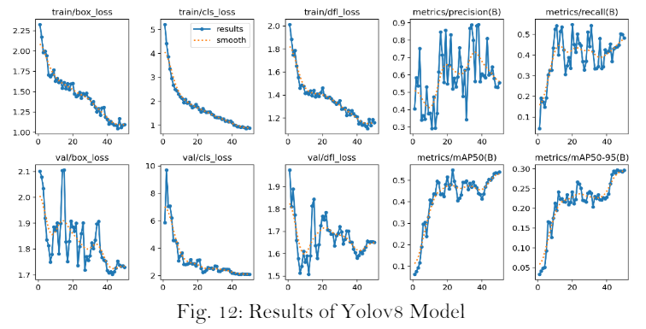
Experimentation Results

Slide 19
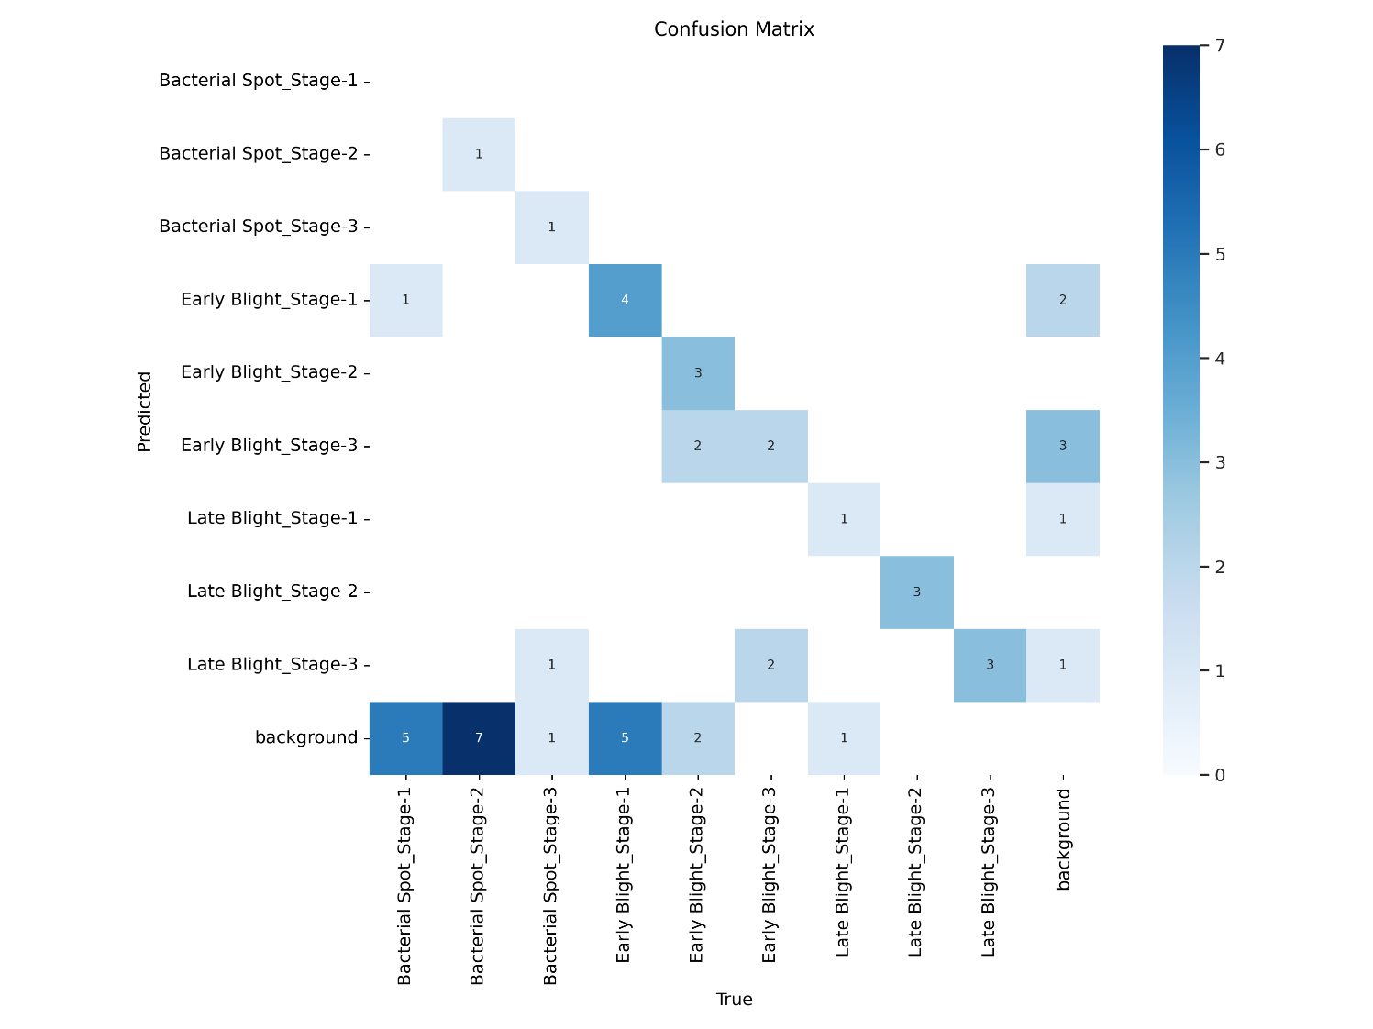
Experimentation Results
Fig: Confusion Matrix of Yolov8 Model

Slide 20
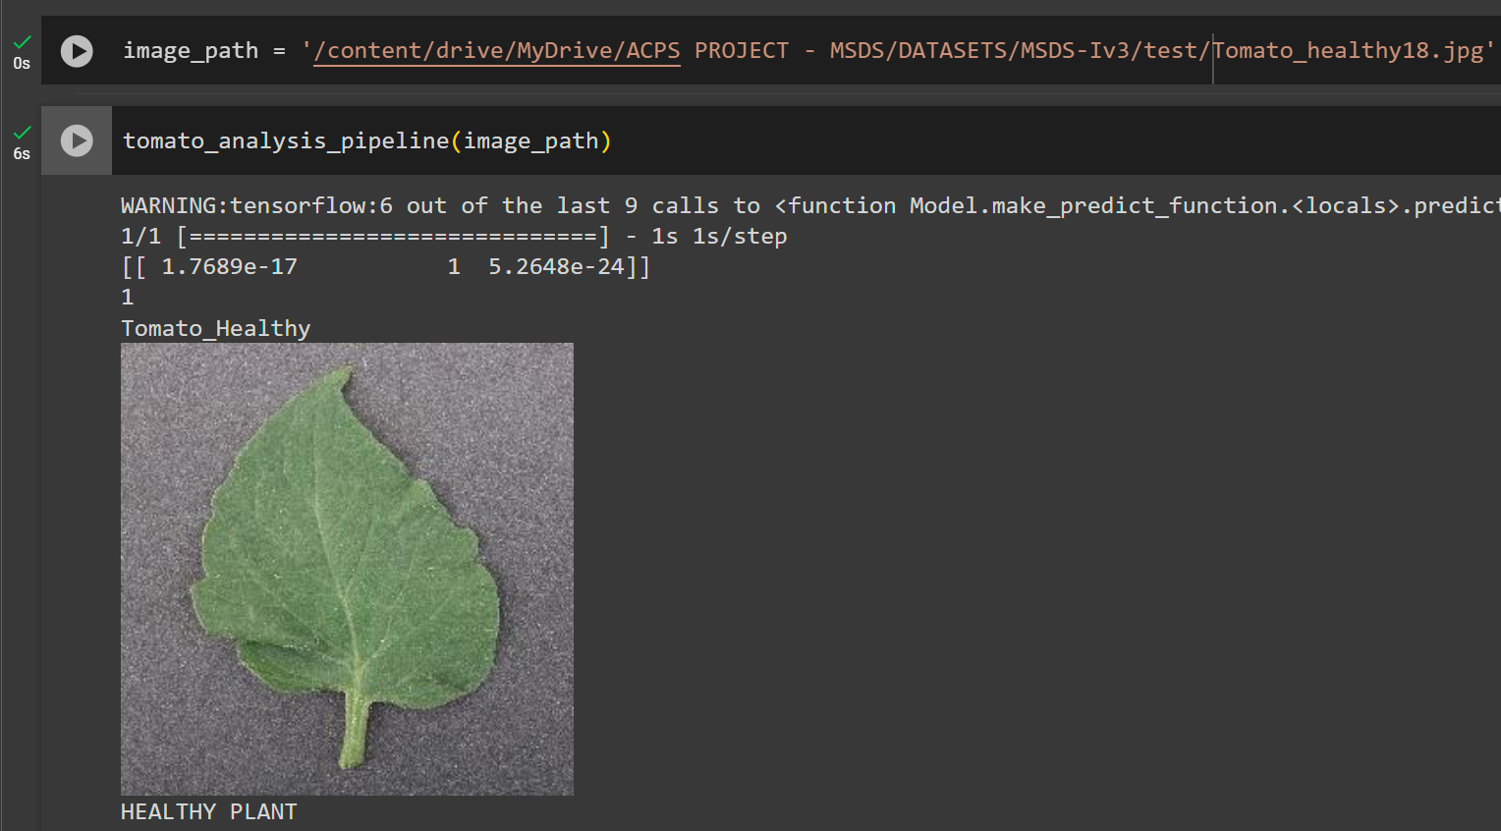
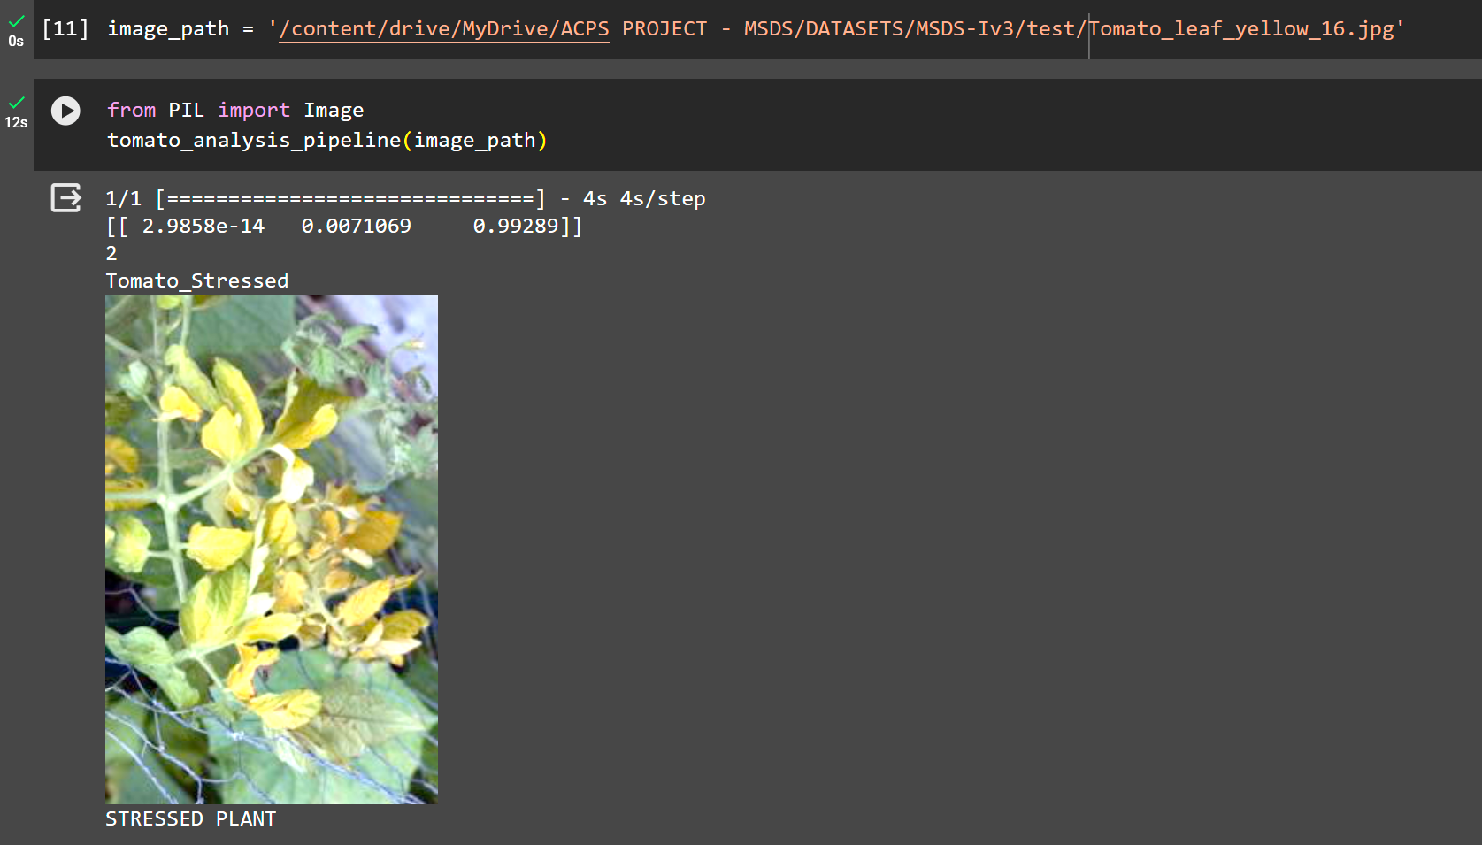
Experimentation Results

Slide 21
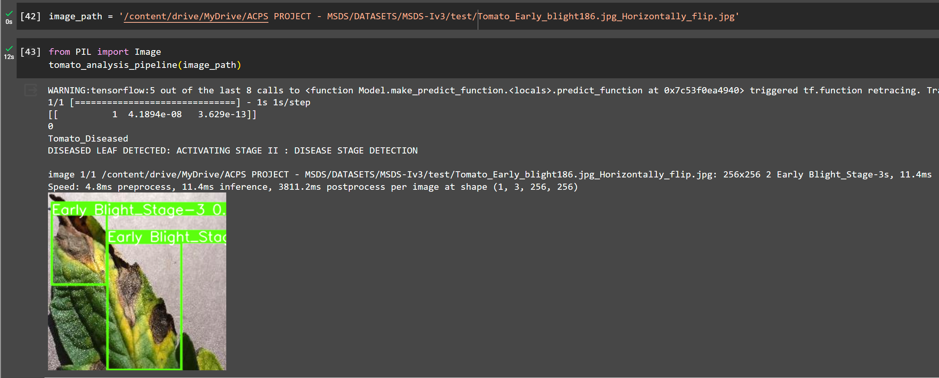
Experimentation Results

Slide 22
DISCUSSION
Key Findings:
Two-stage pipeline effectively combines classification and object detection
Stage 1 (Inception v3) accurately distinguishes stressed vs diseased leaves
Stage 2 (YOLOv8) precisely detects disease type and progression stage
Implications:
Enables early and accurate diagnosis of tomato plant diseases
Localizes affected areas, allowing targeted treatment
Identification of disease stage guides appropriate remedial actions
Potential to improve crop yield and reduce losses
Significance:
Addresses limitations of existing methods (ambiguity, lack of localization, no staging)
Novel MSDS-Yv8 dataset with annotated disease stages
End-to-end solution through web application interface
Extensible to other crop types and diseases

Slide 23
CONCLUSION
Developed a two-stage deep learning pipeline
Deployed an end-to-end web application interface
Accurate differentiation between stressed and diseased leaves
Early detection and localization of tomato leaf diseases
Identification of disease progression stage for targeted remedial actions
Potential to improve crop yield and reduce losses

Slide 24
FUTURE WORK
Expand the dataset to include more crop types and diseases
Integrate stress analysis and remedial suggestions
Enhance web app with data analysis and commercial features
Investigate integration with IoT and smart farming systems
Develop mobile app versions for increased accessibility

Slide 25
REFERENCES
Kwabena, P. M. (2023, April). Dataset for Crop Pest and Disease Detection, Version 1. Retrieved March 19, 2024. https://data.mendeley.com/datasets/bwh3zbpkpv/1
Davinder Singh, Naman Jain, Pranjali Jain, Pratik Kayal, Sudhakar Kumawat and Nipun Batra (2020). “PlantDoc: A Dataset for Visual Plant Disease Detection”, Version 1. Retrieved March19, 2024. https://www.kaggle.com/datasets/abdulhasibuddin/plant-doc-dataset
Al‐gaashani, M. S., Shang, F., Muthanna, M. S., Khayyat, M., & Abd El‐Latif, A. A. (2022). Tomato leaf disease classification by exploiting transfer learning and feature concatenation. IET Image Processing, 16(3), 913-925.
Hughes, D., & Salathé, M. (2015). “An open access repository of images on plant health to enable the development of mobile disease diagnostics”. arXiv preprint arXiv:1511.08060.

Slide 26
THANK YOU

